Slide 1
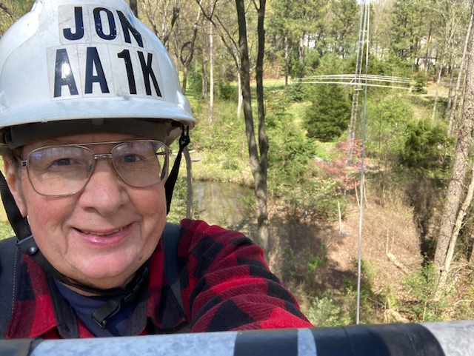
Tips for Topband success
AA1K, Jon P. Zaimes, May 19, 2023, Topband Dinner, Hope Hotel, Dayton, Ohio

Slide 2
Tip 1: Antennas must be big

Slide 3
AA1K/m
Serious mobile operation on 160 meters from 2000 VW Jetta, 2000-2009. Racked up 327,000 miles. Another 200,000 miles on 2009 Jetta.
54 countries worked on Topband with KJ7U screwdriver.
First QSO was with VK3ZL. Numerous Europeans. G3PQA best ears.
Rig was Icom 706Mk2G with 100 watts.
All QSOs on CW, with Vibroplex junior paddle sitting on passenger seat. No memory keyer.
QSOs made during my normal commute, no special trips to work DX
Delaware Route 1 is newer highway, no power lines. RF quiet
Diesel engine made for quiet noise floor. No ignition noise.

Slide 4
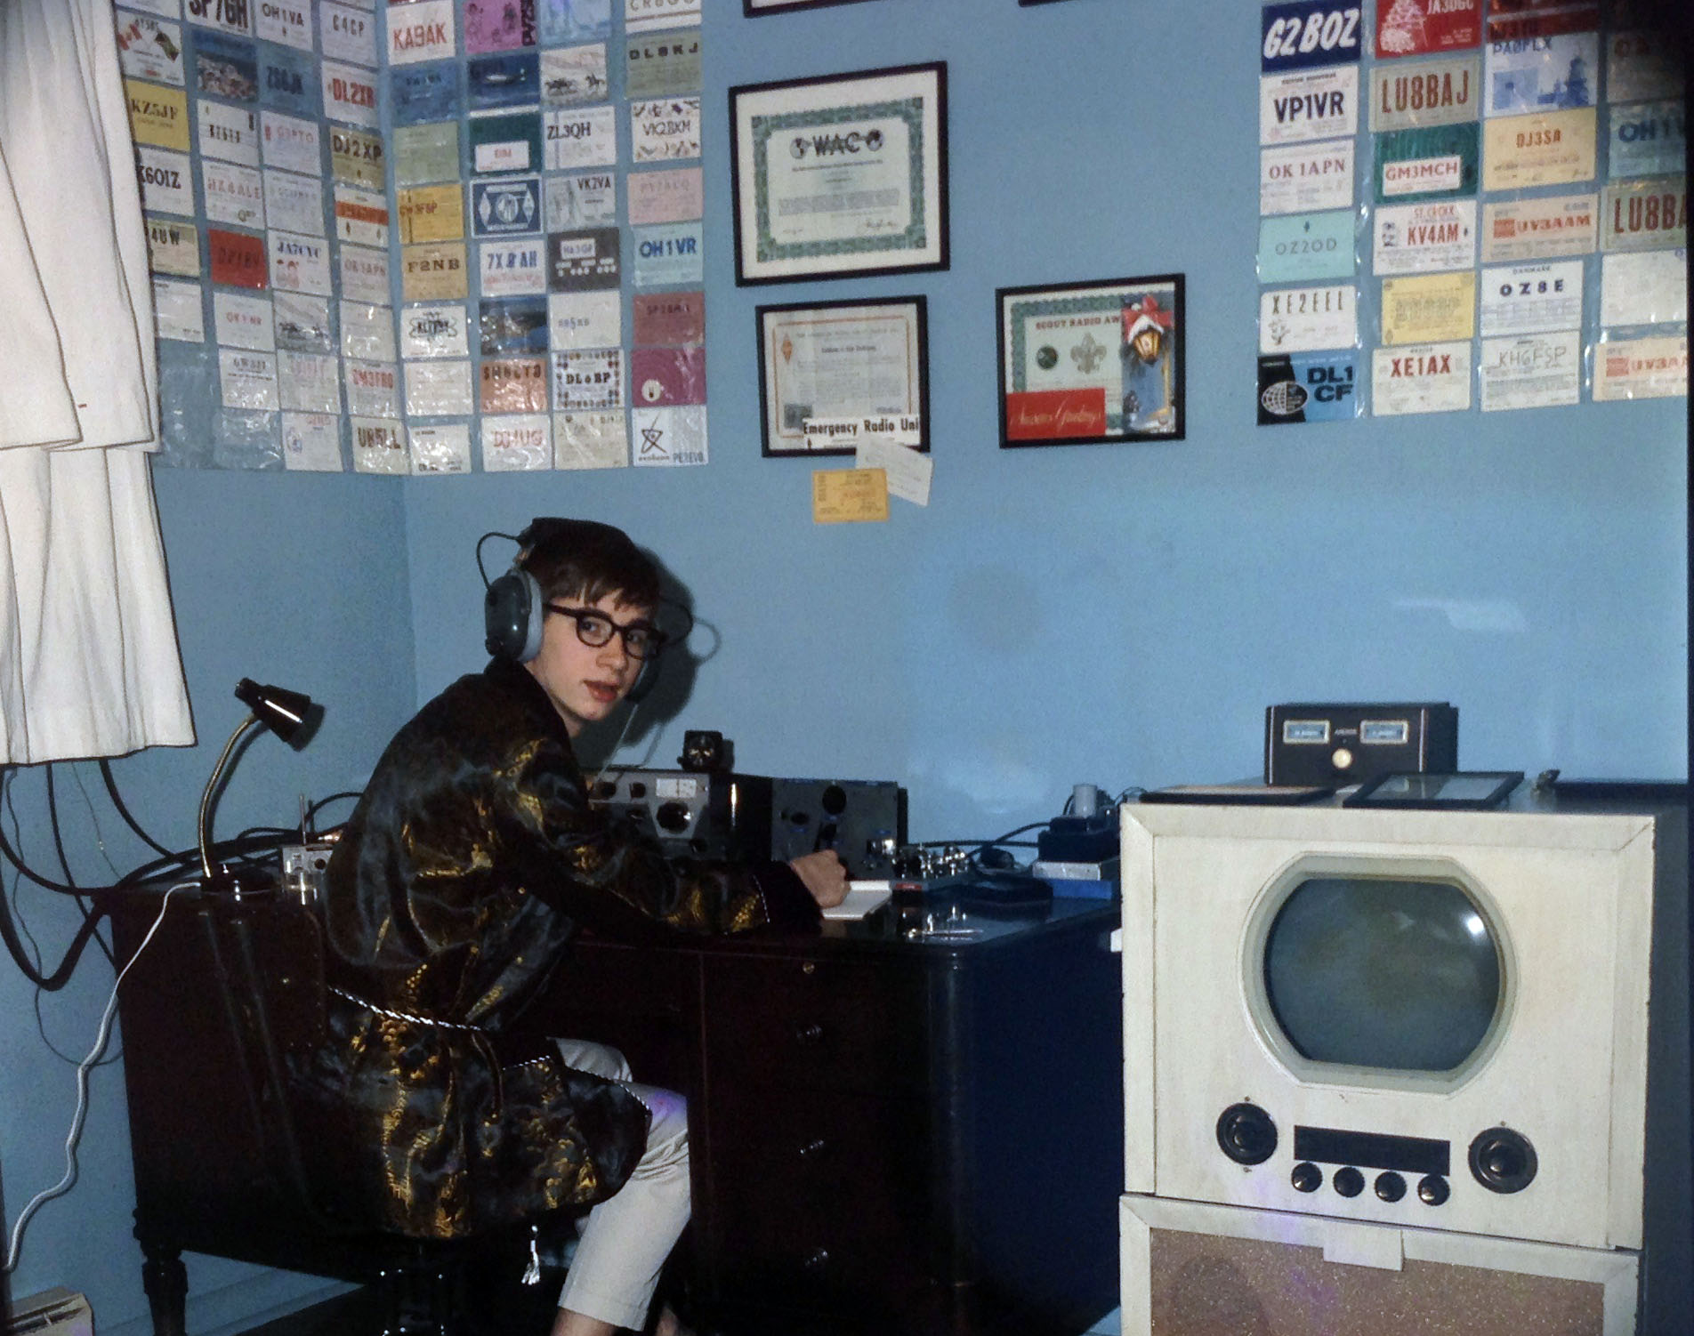
Early years

Slide 5
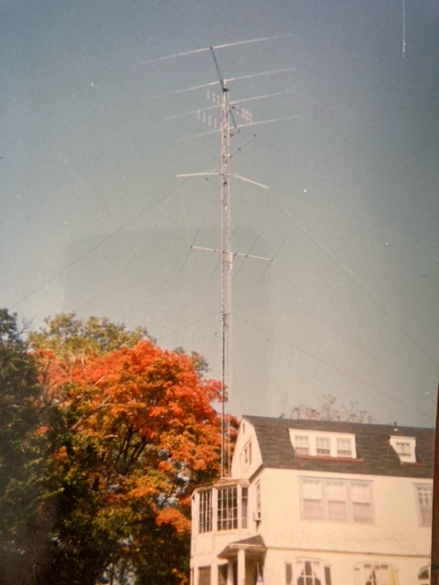
Tip 2: Never quit early
How a coffee break may have cost me a new one in QTH north of Wilmington, Delaware. Tower is 120 feet with ½ wave sloper for Topband.

Slide 6
Tip 3: Always be prepared
2007 summer vacation trip to Rangely Lake in Maine turned into portable operation to chase a needed one on 160

Slide 7
Tip 5: Acquire more land Moved in December 1997 Original property 12 acres Added upper 5.5 acres in 2014

Slide 8
Tip 6: More antennas is better

Slide 9
Red dots: Eight Rohn guyed towers Blue dots: JA/SE BSEF receive short vertical array Green dots: Eu/SW BSEF receive short vertical array White dots: Phased short verticals for in-band RX Thin colored lines: Single-wire Beverages Thick colored lines: Phased Beverage pairs

Slide 10
160-meter driven element in modified K3LR array at AA1K

Slide 11
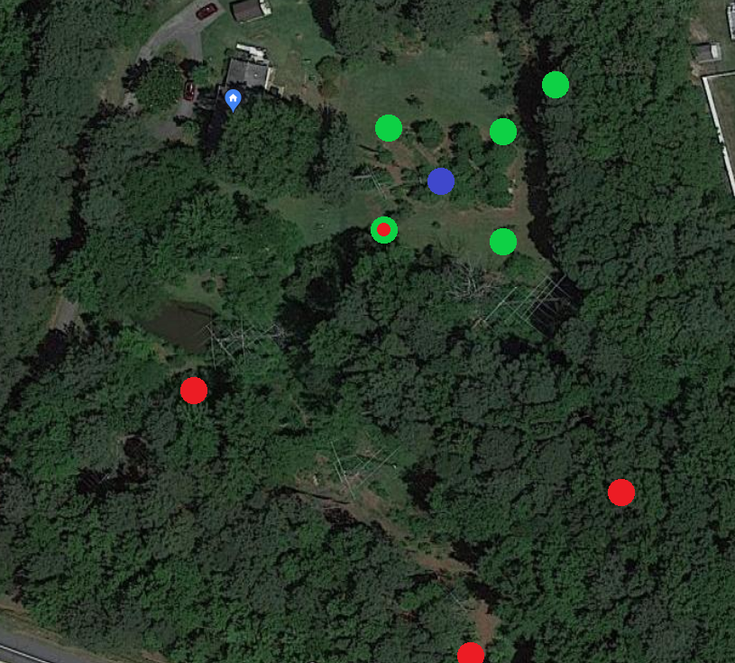
Blue dot: Rohn 25 tower, series fed with insulated guys
LP and 6m yagi at top make tower resonant around 1400 kHz
Green dots: Four wire t-shaped parasitic elements hang from tower
Switchable NE, SE, SW, NW as 3-element array for 5.3 db gain
Extra element to NE adds 0.9 db gain to Europe
Red dots: BSEF TX array

Slide 12
160 second director

Slide 13
BSEF TX array
Four vertical elements with footprint of 146 x 320 feet
Each element has 120 radials each 130 feet on the ground
Forward elements t-shaped wires, 73.5 feet tall with 58-foot tophat
Rearward elements are inverted L’s
One element shared with original K3LR parasitic array, relay switched
Elements resonant around 1930 kHz. Small coil resonates to 1830.
Two forward elements (toward Europe) fed in parallel via 320-foot, 7/8” 50-ohm hardline. Two rearward elements have coils to resonate at 1795 kHz, making them reflectors.
About 8.5 db gain over single element

Slide 14
Broadside endfire transmit array

Slide 15
Tip 7: Everything need not be neat and in a box

Slide 16
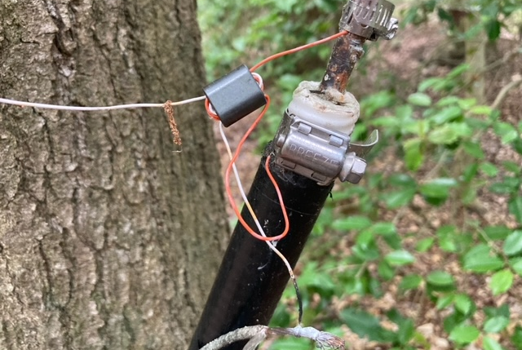
Beverage feedpoints

Slide 17
Tip 8: Everything does not need to be new and shiny
Green amp at right is single 4-1000 glass tube amp used on 160 meters at AA1K for about 25 years. It was at least that old when I acquired it in 1984.

Slide 18
Tip 9: Scrounge lots of wire and cable

Slide 19
AA1K by the numbers
Eight Rohn guyed towers, totaling 736 feet of tower
125,000 feet of radial wire, sizes from no. 24 to no. 10
20,000+ feet of hardline and coax
19 HF and 6m yagis (more in progress)
24 single-wire and phased Beverages
Four broadside/endfire 34-foot-tall receiving vertical arrays
One two-element 34-foot receiving vertical array

Slide 20
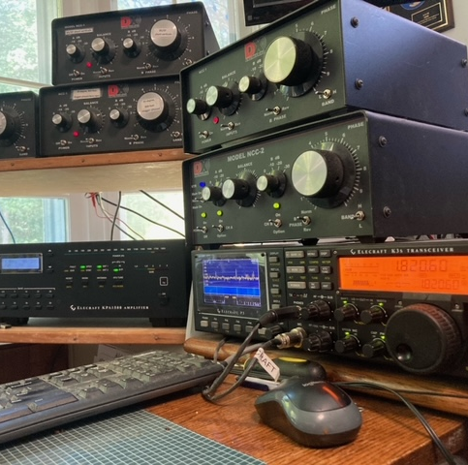
Tip 10: Accessories help

Slide 21
Leave time for maintenance

Slide 22
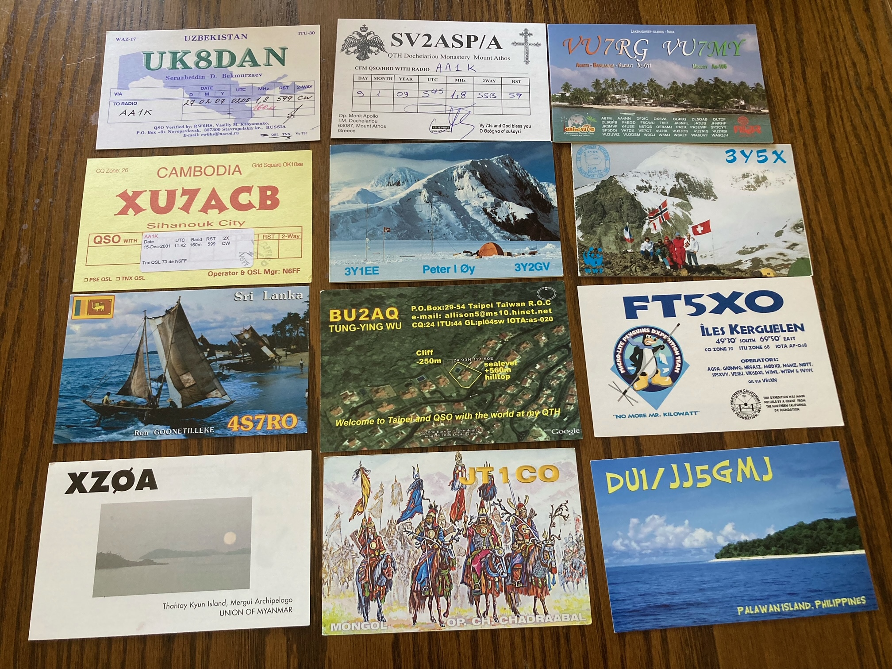
Results
329 entities confirmed on Topband
All 40 zones confirmed
First place USA single op CQ WW 160m contest (1987, 1990, 2000, 2022)

Slide 23
Website: AA1K.us

